Slide 1


ZXdata labs
Challenge: Thread-X

Slide 2

Current Problems We Want to Solve:
1. Communication Gaps:
No seamless connectivity across controls, HPC, cloud, and mobile platforms.
2. Lack of Standardization:
No unified data model to standardize vehicle interfaces.
3. Limited Scalability:
Existing frameworks can't easily adapt to new features.
4. Update Misalignment:
Cloud and vehicle updates risk compatibility issues.

Slide 3
Solutions & Target Goals
1. Communication Framework:
Develop a transport abstraction layer to support flexible communication protocols like MQTT.
2. Unified Data Model:
Standardize interfaces with a global namespace, enabling publish/subscribe and request/response mechanisms.
3. Modular Architecture:
ECU Abstraction: Simplify hardware interactions.
Service Abstraction: Aggregate services for advanced vehicle functionalities.
4. Forward Compatibility:
Support asynchronous updates between cloud and vehicles.

Slide 4
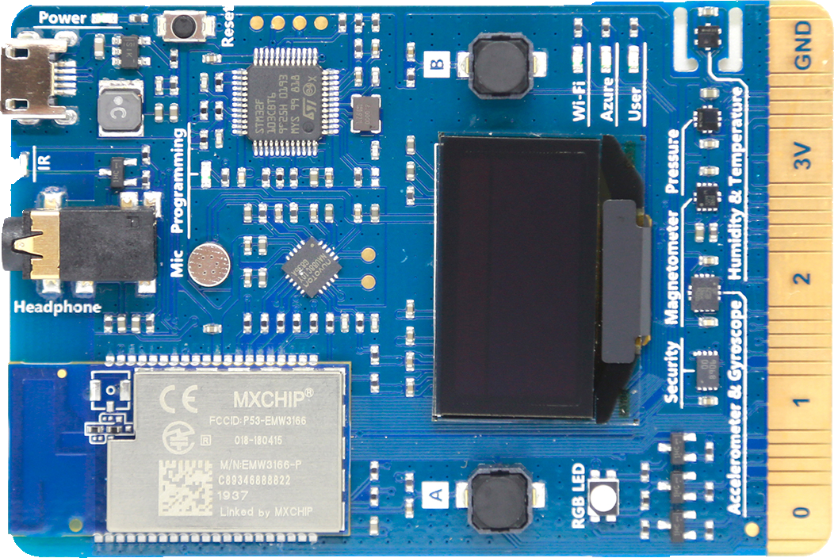
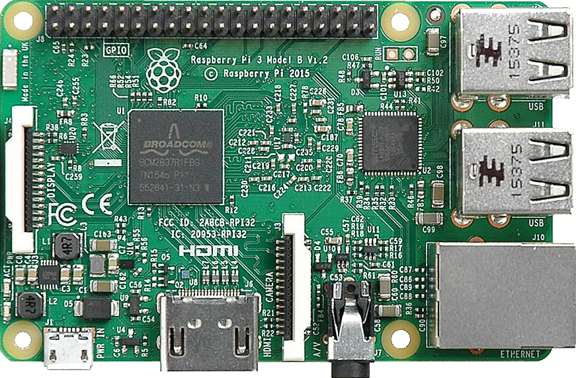
Architecture
HPC
MQTT
MQTT
Rx/Tx
Rx/Tx
ECU_
Temperature_Sensor
ECU_
Fan_Speed

Slide 5

Architecture
HPC
ECU_
FRONT_RIGHT
ECU_
BACK_RIGHT
ECU_
FRONT_LEFT
ECU_ BACK_Left

Slide 6

outlook
Cloud

Slide 7
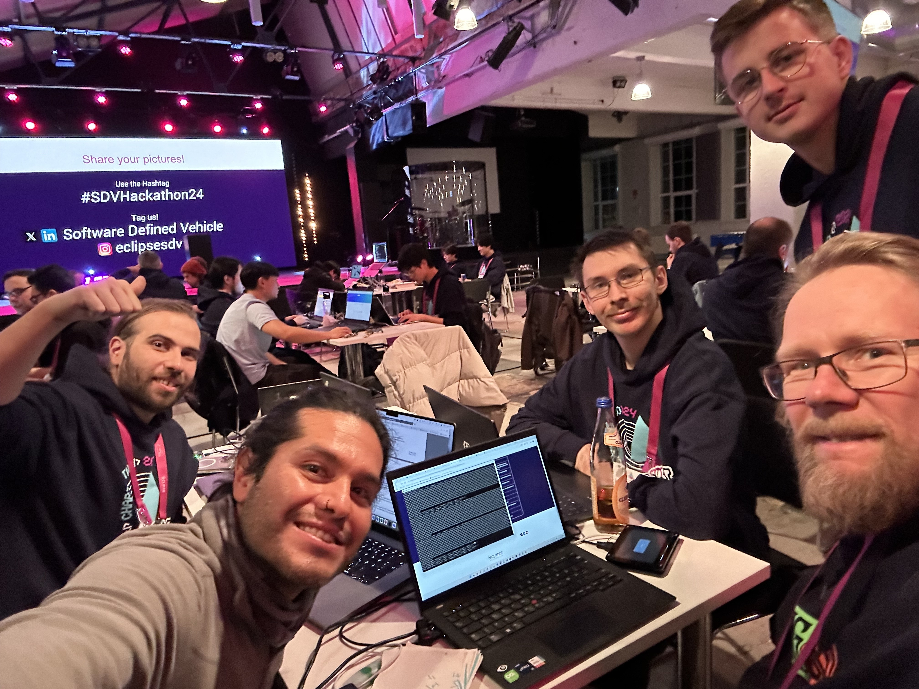
Thank you!

